Slide 1
SURFACE AREA AND VOLUME

Slide 2
SURFACE AREA AND VOLUME
SURFACE AREA AND VOLUME
Introduction
Concept of 3D figures (types and characteristics): Cube, Cuboid, Cylinder, Cone, Sphere and Hemisphere
Surface area (total and curved/lateral) and Volume of 3D figures
DS on based topic

Slide 3
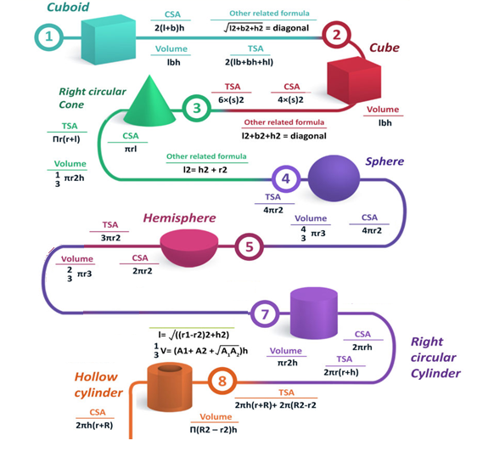
SURFACE AREA AND VOLUME

Slide 4
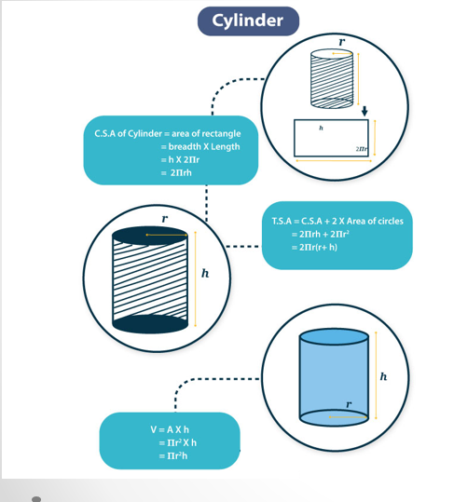
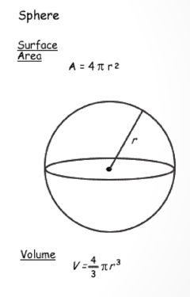
SURFACE AREA AND VOLUME
Sphere

Slide 5
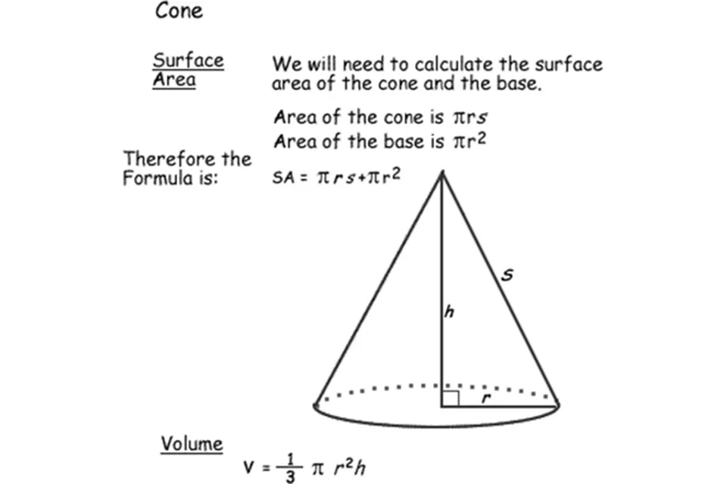
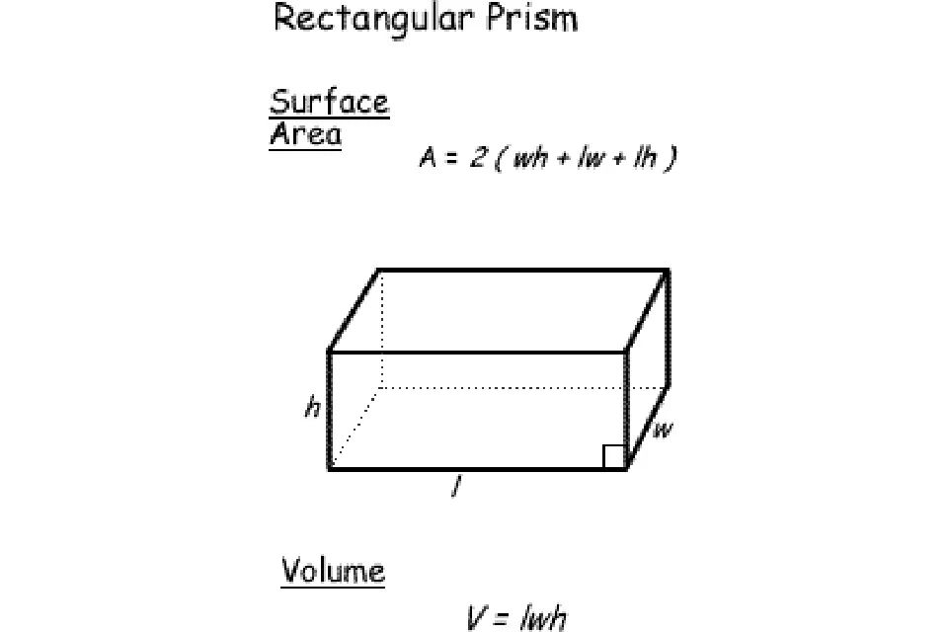
SURFACE AREA AND VOLUME
Cone
Cuboid

Slide 6
SURFACE AREA AND VOLUME
1. The radii of two cylinders are in the ratio of 2: 3 and their heights are in the ratio of 4:5. The ratio of their volume is?
A. 4: 9
B. 9: 4
C. 20: 27
D. 16:45
Notes:
Option D
(Compulsory)
(Easy)

Slide 7
SURFACE AREA AND VOLUME
2. A copper sphere of radius 9 cm is beaten and drawn into a wire of diameter 0.2 cm. The length of the wire is?
A. 972 m
B. 912 m
C. 932 m
D. 936 m
Notes:
Option A
(Optional)
(Easy)

Slide 8
SURFACE AREA AND VOLUME
3. The length, breadth, and height of a brick are 10 cm, 4 cm, and 5 cm, respectively. Find the total surface area of the brick?
A. 154 cm²
B. 200 cm²
C. 220 cm²
D. 164 cm²
Notes:
Option C
(Compulsory)
(Easy)

Slide 9
SURFACE AREA AND VOLUME
4. A 5 m long and 4 m wide cistern contains water up to a breadth of 1 m 25 cm. Find the total surface area of the surface submerge in water?
A. 42.5 m²
B. 49.5 m²
C. 52.5 m²
D. 64.5 m²
Notes:
Option A
(Optional)
(Easy)

Slide 10
SURFACE AREA AND VOLUME
5. A boat of length 4 m and breadth 3 m is floating on a lake. The boat sinks by 1 cm when a man gets into it. What is the mass of the man?
A. 120 Kg
B. 100 Kg
C. 90 Kg
D. 80 Kg
Notes:
Option A
(Compulsory)
(Easy)

Slide 11
SURFACE AREA AND VOLUME
6. How many bricks, each measuring 25cm x 11.25cm x 8cm, will be needed to build a wall 8m x 7m x 22.5m?
A. 540000
B. 560000
C. 630000
D. 640000
Notes:
Option B
(Optional)
(Easy)

Slide 12
SURFACE AREA AND VOLUME
7. From a cylindrical vessel having radius of the base 7 cm and height 8 cm, water is poured into small hemispherical bowls each of radius 3.5 cm. Find the minimum number of bowls that would be required to empty the cylindrical vessel.
A. 10
B. 11
C. 13
D. 14
Notes:
Option D
(Compulsory)
(Moderate)

Slide 13
SURFACE AREA AND VOLUME
8. 4 cm of rain has fallen on a square km of land. Assuming that 60% of the raindrops could have been collected and contained in a pool having a 300m x 20m base, by what level would the water level in the pool have increased?
A. 4 m
B. 6 m
C. 9 m
D. 10 m
Notes:
Option A
(Compulsory)
(Moderate)

Slide 14
SURFACE AREA AND VOLUME
9. If two adjacent sides of a rectangular parallelepiped are 4 cm and 6 cm and the total surface area of parallelepiped is 108 cm², then the diagonal of the parallelepiped is?
A. √55
B. √61
C. √67
D. √70
Notes:
Option B
(Optional)
(Moderate)

Slide 15
SURFACE AREA AND VOLUME
10. A largest possible rod of length 84√3 cm can be placed in a cubical room. The surface area of the largest possible sphere that fit within the cubical room is (π =22/7) (in Sq. m) is?
A. 24186
B. 22176
C. 20582
D. 19864
Notes:
Option B
(Optional)
(Moderate)

Slide 16
SURFACE AREA AND VOLUME
11. A metallic hemisphere is melted and recast in the shape of cone with the same base radius 4 cm as that of the hemisphere. Find the height of the cone?
A. 5
B. 6
C. 8
D. 10
Notes:
Option C
(Compulsory)
(Moderate)

Slide 17
SURFACE AREA AND VOLUME
12. If the radius of the sphere is increased by 4 cm, its surface area increased by 1408 cm². The radius of the sphere before change is :
A. 12
B. 9
C. 8
D. 5
Notes:
Option A
(Optional)
(Moderate)

Slide 18
SURFACE AREA AND VOLUME
13. The height of a conical tank is 12 cm and the diameter of its base is 32 cm. The cost of painting if from outside at the rate of Rs. 35 per sq. m. is?
A. 53420
B. 45260
C. 35200
D. 26500
Notes:
Option C
(Compulsory)
(Moderate)

Slide 19
SURFACE AREA AND VOLUME
14. The total surface area of a metallic hemisphere is 462 cm². A solid right circular cone is formed after melting the hemisphere. If the radius of the base of the cone is same as the radius of the hemisphere its height is?
A. 12
B. 14
C. 16
D. 18
Notes:
Option B
(Compulsory)
(Moderate)

Slide 20
SURFACE AREA AND VOLUME
15. Balls of the marbles of diameter 1.4 cm diameter are dropped into a cylindrical beaker containing some water and fully submerged. The diameter of the beaker is 14 cm. Find how many marbles have been dropped in it if the water rises by 5.6 cm?
A. 525
B. 575
C. 600
D. 625
Notes:
Option C
(Optional)
(Moderate)

Slide 21
SURFACE AREA AND VOLUME
16. By melting a solid lead sphere of radius 6 cm, three small spheres are made whose radii are in ratio 3:4:5. The radius of the smallest sphere is?
A. 3
B. 4
C. 5
D. 6
Notes:
Option A
(Optional)
(Moderate)

Slide 22
SURFACE AREA AND VOLUME
17. Find the number of bricks, each measuring 30 cm x 10 cm x 8 cm, required to construct a wall 24 m long, 8 m high and 60 cm thick, if 10% of the wall is filled with mortar?
A. 35000
B. 43200
C. 55600
D. 65800
Notes:
Option B
(Compulsory)
(Moderate)

Slide 23
SURFACE AREA AND VOLUME
18. A large cube is formed from the material obtained by melting three smaller cubes of 3, 4 and 5 cm side. What is the ratio of the total surface areas of the smaller cubes and the large cube?
A. 15: 9
B. 18: 15
C. 20: 27
D. 25: 18
Notes:
Option D
(Optional)
(Moderate)

Slide 24
SURFACE AREA AND VOLUME
19. A hollow iron pipe is 21 cm long and its external diameter is 8 cm. If the thickness of the pipe is 1 cm and iron weighs 8g/cu.cm, then the weight of the pipe is?
A. 3.6 kg
B. 36 kg
C. 3.696 kg
D. 36.9 kg
Notes:
Option C
(Compulsory)
(Moderate)

Slide 25
SURFACE AREA AND VOLUME
20. If the height of a given cone be doubled and radius of the base becomes half, the ratio of the volume of the given cone to that of the second cone will be?
A. 2:3
B. 1:8
C. 3:2
D. None of these
Notes:
Option D
(Optional)
(Moderate)

Slide 26
SURFACE AREA AND VOLUME
21. The numerical values of the volume and the area of the lateral surface of a right circular cone are equal. If the height of the cone be h and radius be r, the value of r²h²/(r²+h²)is?
A. 1/9
B. 1/3
C. 3/1
D. 9/1
Notes:
Option D
(Compulsory)
(Moderate)

Slide 27
SURFACE AREA AND VOLUME
22. A sphere of radius ‘r’ is cut on a plane at the distance of ‘h’ from its center, thereby breaking this sphere into two different pieces. The cumulative surface area of these two pieces is 25% more than that of the sphere. Find ‘h’.
A. r/(√3)
B. r/(√2)
C. r/(√6)
D. r/(√5)
Notes:
Option B
(Optional)
(Moderate)

Slide 28
SURFACE AREA AND VOLUME
23. The total surface area of a solid cylinder is 462 cm². The area of the curved surface is 1/3 of the total surface area. The volume of cylinder is?
A. 530 cm²
B. 536 cm²
C. 539 cm²
D. 545 cm²
Notes:
Option C
(Optional)
(Moderate)

Slide 29
SURFACE AREA AND VOLUME
24. The radii of bases, as well as the height of a cylinder and a cone, are equal. If their curved surfaces areas are in the ratio of 24 : 13, the ratio of their radii and heights is?
A. 4: 9
B. 9: 4
C. 12: 5
D. 5: 12
Notes:
Option D
(Optional)
(Moderate)

Slide 30
SURFACE AREA AND VOLUME
25. An inverted right circular cone has a radius of 9 cm. This cone is partly filled with oil which is dipping from a hole in the tip at a rate of 1cm²/hour. Currently the level of oil 3 cm from top and surface area is 49π cm². How long will it take the cone to be completely empty?
A. 72π hours
B. 1 hour
C. 3 hours
D. 98π hours
Notes:
Option D
(Compulsory)
(Moderate)

Slide 31
SURFACE AREA AND VOLUME
27. A right circular cone, of height 12 ft, stands on its base which has diameter 8 ft. The tip of the cone is cut off with a plane which is parallel to the base and 8 ft from the base. With π = 22/7, the approximate volume, in cubic ft, of the remaining part of the cone is?
A. 198
B. 194
C. 190
D. 186
Notes:
Option B
(Compulsory)
(Moderate)

Slide 32
SURFACE AREA AND VOLUME
28. Two small circular parks of diameters 10 m and 24 m are to be replaced by a bigger circular park. What would be the diameter of this new park, in meter, if the new park occupies the same space as the two small parks (in meter)?
5
12
20
26
Notes:
Option D
(Optional)
(Moderate)

Slide 33
SURFACE AREA AND VOLUME
29. A rectangular block has the dimensions 5x6x7 cm it is dropped into a cylindrical vessel of radius 6 cm and height 10 cm. If the level of the fluid in the cylinder rises by 4 cm, What portion of the block is immersed in the fluid ?
22/7 x 24/35
22/7 x 36 x 4
22/7 x 36/5
22/7 x 3/7
Notes:
Option D
(Compulsory)
(Moderate)

Slide 34
SURFACE AREA AND VOLUME
30. The sum of the lengths of the edges of a cube is equal to five times the perimeter of a square. If a quarter of the numerical value of the volume of the cube is equal to the numerical value of the area of the square, then the length of one side of the square is?
27/16 units
27 units
9/4 units
None of these
Notes:
Option D
(Compulsory)
(Moderate)

Slide 35
SURFACE AREA AND VOLUME
31. What is the weight of the iron beam?
I. The beam is 10 m long, 35 cm wide and 20 cm high.
II. Iron weighs 60 kg per cubic meter.
A. If Statement I is sufficient for the answer.
B. If Statement II is sufficient for the answer.
C. If Statement I and II are sufficient for the answer but neither of the two alone is sufficient.
D. If Statement I or II is sufficient for the answer.
E. both Statement I and II are insufficient for the answer.
Notes:
Option C
(Compulsory)
(Moderate)

Slide 36
SURFACE AREA AND VOLUME
32. What is the volume of 48 meter high cylindrical tank?
I. The area of its base is 154 sq. m.
II. The diameter of the base is 14 m..
A) If the data in statement I alone is sufficient to answer the question.
B) If the data in statement II alone is sufficient to answer the question.
C) If the data either in statement I alone or statement II alone are sufficient to
answer the question.
D) If the data given in both I and II together are not sufficient to answer the question.
E) If the data in both the statements I and II together are necessary to answer the question.
Notes:
Option C
(Optional)
(Moderate)

Slide 37
SURFACE AREA AND VOLUME
33. What is the volume of a cube?
I. The area of each face of the cube is 49 sq. m.
II. Length of one side of the cube is 7 metres.
A) If the data in statement I alone is sufficient to answer the question.
B) If the data in statement II alone is sufficient to answer the question.
C) If the data either in statement I alone or statement II alone are sufficient to answer the question.
D) If the data given in both I and II together are not sufficient to answer the question.
E) If the data in both the statements I and II together are necessary to answer the question.
Notes:
Option C
(Compulsory)
(Moderate)

Slide 38
SURFACE AREA AND VOLUME
34. What is the capacity of the cylindrical tank?
I. The area of the base is 61,600 sq. cm.
II. The height of the tank is 2.5 times the radius.
III. The circumference of base is 880 cm.
A. Only I and II
B. Only II and III
C. Only I and III
D. Any two of the three
E. Only II and either I or III.
Notes:
Option E
(Compulsory)
(Moderate)

Slide 39
Any Doubts???

